Slide 1
Stacks and Queues

Slide 2
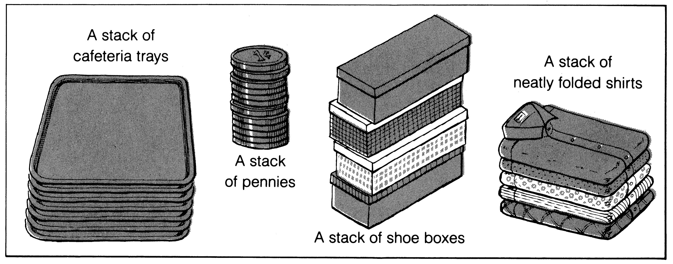
What is a stack?
It is an ordered group of homogeneous items of elements.
Elements are added to and removed from the top of the stack (the most recently added items are at the top of the stack).
The last element to be added is the first to be removed (LIFO: Last In, First Out).

Slide 3
Stack Specification
Definitions: (provided by the user)
  MAX_ITEMS: Max number of items that might be on the stack
  ItemType: Data type of the items on the stack
Operations
  MakeEmpty
  Boolean IsEmpty
  Boolean IsFull
  Push (ItemType newItem)
  Pop (ItemType& item) (or pop and top)

Slide 4
Push (ItemType newItem)
Function: Adds newItem to the top of the stack.
Preconditions: Stack has been initialized and is not full.
Postconditions: newItem is at the top of the stack.

Slide 5
Pop (ItemType& item)
Function: Removes topItem from stack and returns it in item.
Preconditions: Stack has been initialized and is not empty.
Postconditions: Top element has been removed from stack and item is a copy of the removed element.

Slide 6
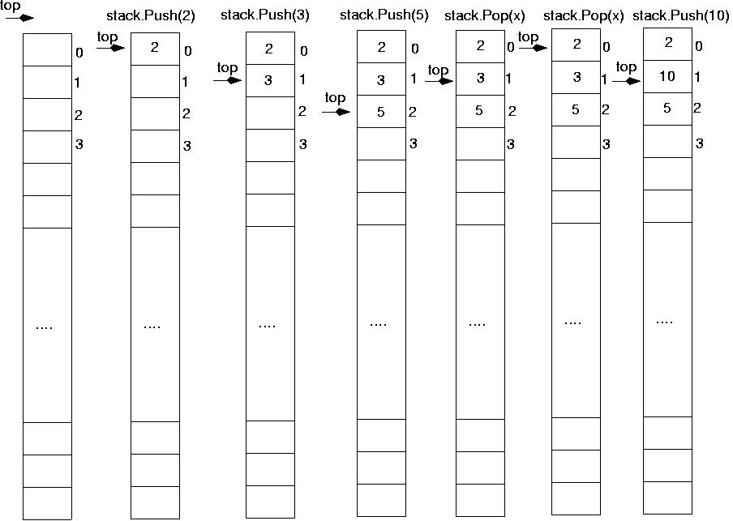

Slide 7
Stack overflow
The condition resulting from trying to push an element onto a full stack.
if(!stack.IsFull())
stack.Push(item);
Stack underflow
The condition resulting from trying to pop an empty stack.
if(!stack.IsEmpty())
stack.Pop(item);

Slide 8
Example: postfix expressions
Postfix notation is another way of writing arithmetic expressions.
In postfix notation, the operator is written after the two operands.
infix: 2+5 postfix: 2 5 +
Expressions are evaluated from left to right.
Precedence rules and parentheses are never needed!!

Slide 9
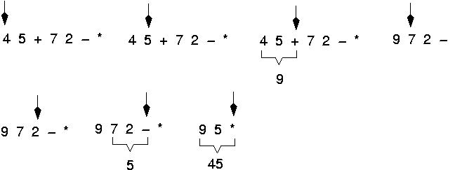
Example: postfix expressions
(cont.)

Slide 10
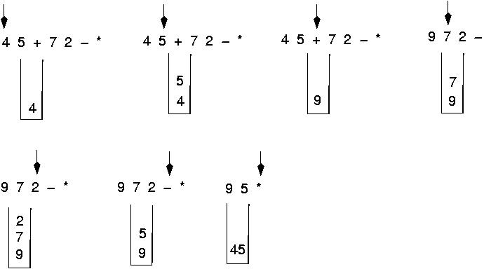
Postfix expressions:
Algorithm using stacks (cont.)

Slide 11
Postfix expressions Evaluation:
Algorithm using stacks
WHILE more input items exist
Get an item
IF item is an operand
stack.Push(item)
ELSE
stack.Pop(operand2)
stack.Pop(operand1)
Compute result
stack.Push(result)
stack.Pop(result)

Slide 12
What is a queue?
It is an ordered group of homogeneous items of elements.
Queues have two ends:
  Elements are added at one end.
  Elements are removed from the other end.
The element added first is also removed first (FIFO: First In, First Out).
tail
queue
head
elements
enter
elements
exit
4
3
2
1
no changes of order

Slide 13
Queue Specification
Definitions: (provided by the user)
  MAX_ITEMS: Max number of items that might be on the queue
  ItemType: Data type of the items on the queue
Operations
  MakeEmpty
  Boolean IsEmpty
  Boolean IsFull
  Enqueue (ItemType newItem)
  Dequeue (ItemType& item) (serve and retrieve)

Slide 14
Enqueue (ItemType newItem)
Function: Adds newItem to the rear of the queue.
Preconditions: Queue has been initialized and is not full.
Postconditions: newItem is at rear of queue.

Slide 15
Dequeue (ItemType& item)
Function: Removes front item from queue and returns it in item.
Preconditions: Queue has been initialized and is not empty.
Postconditions: Front element has been removed from queue and item is a copy of removed element.

Slide 16
Implementation issues
Implement the queue as a circular structure.
How do we know if a queue is full or empty?
Initialization of front and rear.
Testing for a full or empty queue.

Slide 17
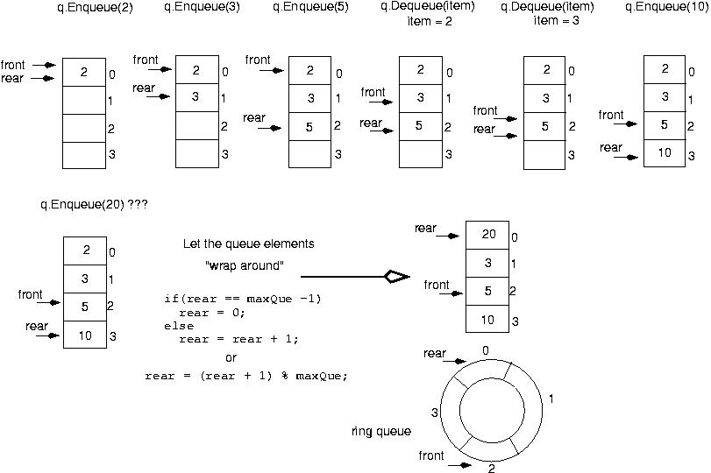

Slide 18
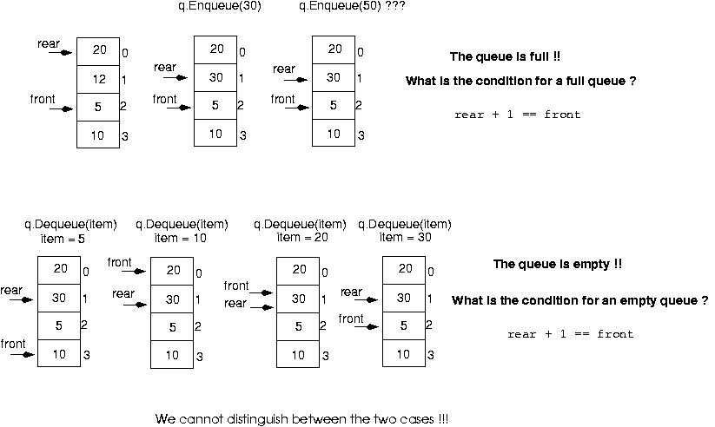

Slide 19
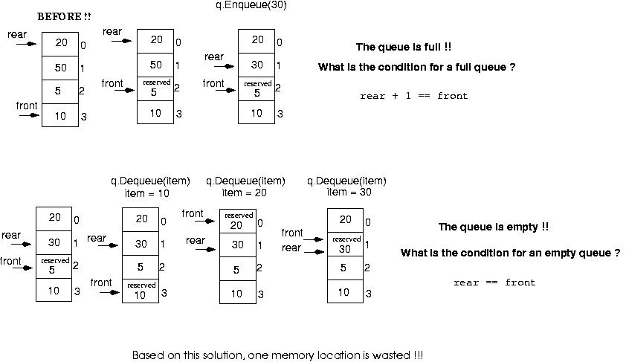
Make front point to the element preceding the front element in the queue (one memory location will be wasted).

Slide 20
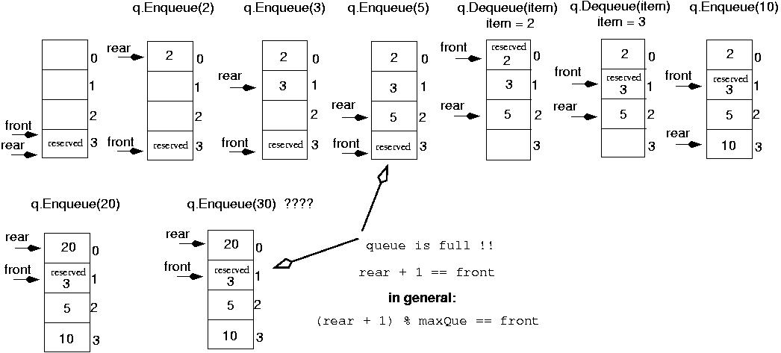
Initialize front and rear

Slide 21
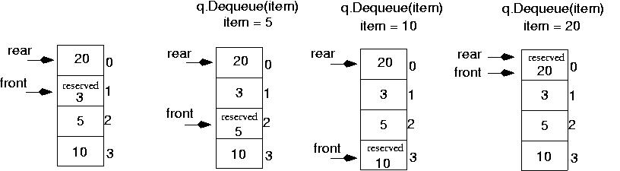
Queue is empty now!!
rear == front

Slide 22
Queue overflow
The condition resulting from trying to add an element onto a full queue.
if(!q.IsFull())
q.Enqueue(item);

Slide 23
Queue underflow
The condition resulting from trying to remove an element from an empty queue.
if(!q.IsEmpty())
q.Dequeue(item);

